Slide 1
Binary file similarity analysis based on graph neural network
Yangyang Zhang
Tongxi Xu
Munich, 06.05.2024
Automated Machine Learning for Multi-Label Classification

Slide 2

Binary file similarity detection model
Dataset (x86/x64)
Extraction of file binary features
Data processing
Demonstration of graph neural network structure
Loss function and optimization method selection
Experimental results display
Possible optimization directions

Slide 3
01 Dataset

Slide 4
Part of Compiled Dataset BinKit2.0
A2ps, binutils(X86/64 Platform)
We use the binary files from these two folders to build CFGs, the binary files in these two folders are compiled by different platforms, compilers, and compilation levels.
Notes:
In general, pre-trained language models are learned on a lot of text data in a self-supervised manner, and then fine-turned on downstream tasks
It is very popular and can effectively improve the performance of many of natural language processing tasks.
In the past year , one of the important trends of pre-trained language models is their increasing model size ,which leads to lower perplexity in pre-training and better performances on downstream tasks
Although they are very successful, however, they are trained on plain text and do not introduce language knowledge, world knowledge etc. In addition, these large models are trained using autoregression, which does not perform well in solving downstream language understanding problems.

Slide 5
02 Extraction of file binary features

Slide 6
Extraction of file binary features
Feature extraction of function is based on the Angr package
Based on: project.analyses.CFGFast() cfg.kb.functions
Analyze on a node basis
Then extra Structural information like:No. of offspring, Betweenness(graph level)
Extra Node internal features like: Numeric Constants, No. of Transfer Instructions(code level)
Extract CFG in function units from binary file
A binary file contains multiple functions. At this time, consider functions have enough blocks(>=3)
And does not consider functions that are system calls
Output result processing
Store the extracted function CFG and file name + function name as the result for subsequent generation of training and test sets.
Notes:
In general, pre-trained language models are learned on a lot of text data in a self-supervised manner, and then fine-turned on downstream tasks
It is very popular and can effectively improve the performance of many of natural language processing tasks.
In the past year , one of the important trends of pre-trained language models is their increasing model size ,which leads to lower perplexity in pre-training and better performances on downstream tasks
Although they are very successful, however, they are trained on plain text and do not introduce language knowledge, world knowledge etc. In addition, these large models are trained using autoregression, which does not perform well in solving downstream language understanding problems.

Slide 7
03 Data processing

Slide 8
data processing
Converting CFGs into matrices
We first transform the generated CFG into a matrix for subsequent operations. Here, each CFG is transformed into two matrices, one is the graph adjacency matrix and the other is the node attribute matrix
Generate positive item and negative item
The form of a postive item is (adjacencyMatrix1, nodeAttributeMatrix1, adjacencyMatrix2, nodeAttributeMatrix2, 1 ). The four matrices come from two different CFGs.
If the two CFGs are generated from the same binary on the same platform using the same compiler with different optimisation levels, then label = 1 is the positive item. Conversely, label = -1 is the negative item.
Building the dataset
Create a graphDataset class that implements the init, len, and getitem methods.

Slide 9
04 Demonstration of graph neural network structure

Slide 10
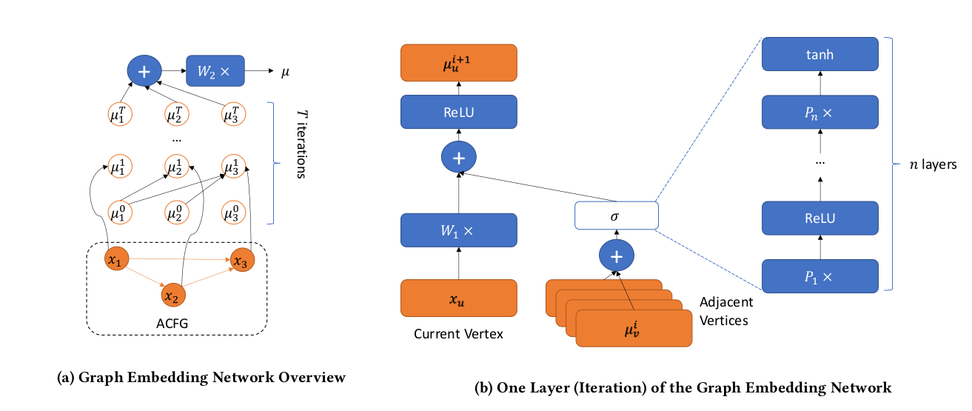
Basic algorithm basis
A
Notes:
In general, pre-trained language models are learned on a lot of text data in a self-supervised manner, and then fine-turned on downstream tasks
It is very popular and can effectively improve the performance of many of natural language processing tasks.
In the past year , one of the important trends of pre-trained language models is their increasing model size ,which leads to lower perplexity in pre-training and better performances on downstream tasks
Although they are very successful, however, they are trained on plain text and do not introduce language knowledge, world knowledge etc. In addition, these large models are trained using autoregression, which does not perform well in solving downstream language understanding problems.

Slide 11
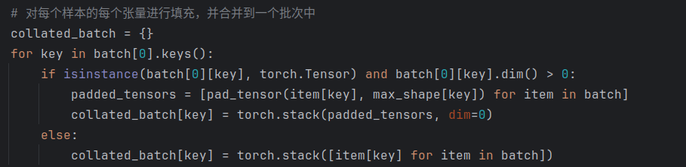
Basic algorithm basis
Neural network built based on the basic MPNN concept
In model.py
class GraphEmbeddingNetwork(nn.Module) is the achievement of previous slide
In the code, we use the padding method to preprocess the input matrix, which allows adjacency matrices and feature matrices of different sizes to participate in training in the form of batch processing.
Notes:
In general, pre-trained language models are learned on a lot of text data in a self-supervised manner, and then fine-turned on downstream tasks
It is very popular and can effectively improve the performance of many of natural language processing tasks.
In the past year , one of the important trends of pre-trained language models is their increasing model size ,which leads to lower perplexity in pre-training and better performances on downstream tasks
Although they are very successful, however, they are trained on plain text and do not introduce language knowledge, world knowledge etc. In addition, these large models are trained using autoregression, which does not perform well in solving downstream language understanding problems.

Slide 12
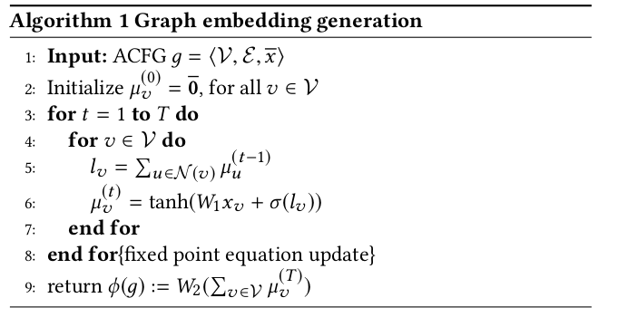
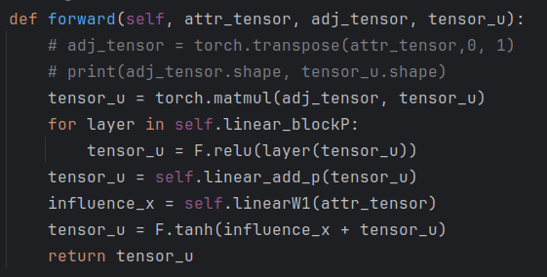
Basic algorithm basis
Then use the for loop in the matrix multiplication optimization algorithm to improve the operation speed
Output is a embedding vector of each input CFG
Notes:
In general, pre-trained language models are learned on a lot of text data in a self-supervised manner, and then fine-turned on downstream tasks
It is very popular and can effectively improve the performance of many of natural language processing tasks.
In the past year , one of the important trends of pre-trained language models is their increasing model size ,which leads to lower perplexity in pre-training and better performances on downstream tasks
Although they are very successful, however, they are trained on plain text and do not introduce language knowledge, world knowledge etc. In addition, these large models are trained using autoregression, which does not perform well in solving downstream language understanding problems.

Slide 13
05 Loss function and optimization method selection

Slide 14
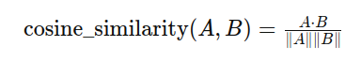
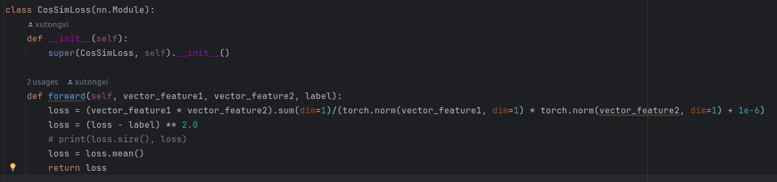
Based on the output of the Neural Networks
Calculate the similarity of two functions based on cosine similarity.
Notes:
In general, pre-trained language models are learned on a lot of text data in a self-supervised manner, and then fine-turned on downstream tasks
It is very popular and can effectively improve the performance of many of natural language processing tasks.
In the past year , one of the important trends of pre-trained language models is their increasing model size ,which leads to lower perplexity in pre-training and better performances on downstream tasks
Although they are very successful, however, they are trained on plain text and do not introduce language knowledge, world knowledge etc. In addition, these large models are trained using autoregression, which does not perform well in solving downstream language understanding problems.

Slide 15
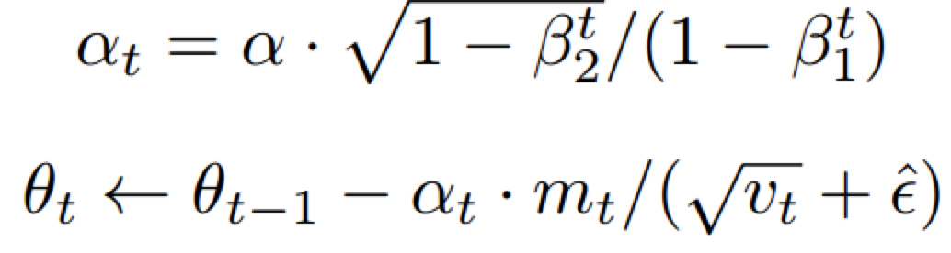
The optimization method is based on Adaptive Moment Estimation
The learning rate gradually increases as training progresses
The update is affected by first-order acceleration and second-order acceleration
Notes:
In general, pre-trained language models are learned on a lot of text data in a self-supervised manner, and then fine-turned on downstream tasks
It is very popular and can effectively improve the performance of many of natural language processing tasks.
In the past year , one of the important trends of pre-trained language models is their increasing model size ,which leads to lower perplexity in pre-training and better performances on downstream tasks
Although they are very successful, however, they are trained on plain text and do not introduce language knowledge, world knowledge etc. In addition, these large models are trained using autoregression, which does not perform well in solving downstream language understanding problems.

Slide 16
06 Experimental results display
Train Dataset
Valid Dataset
Test Dataset

Slide 17
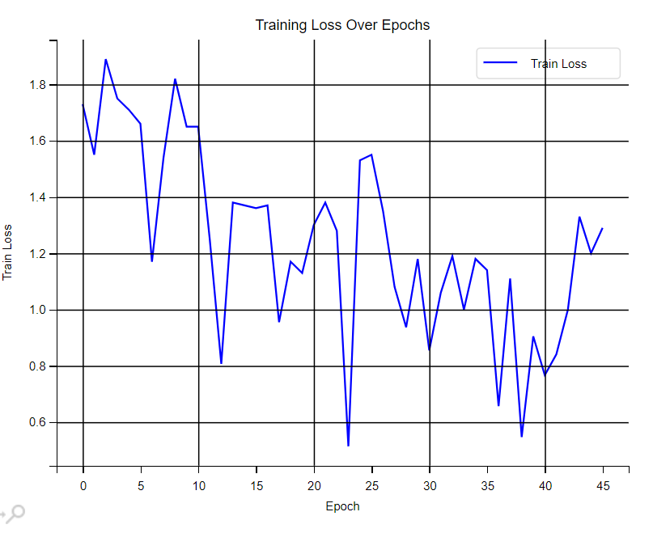
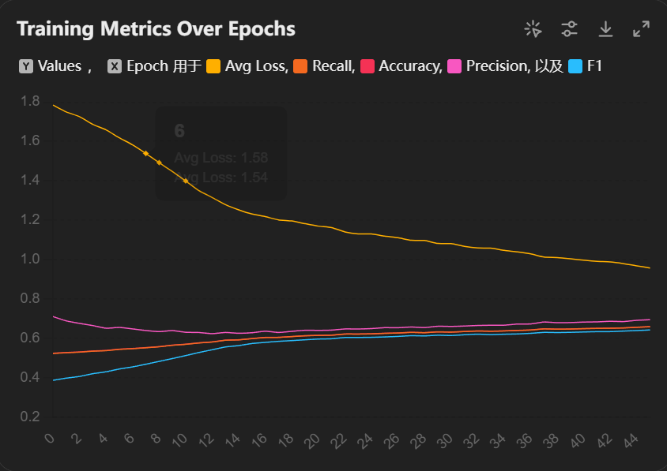
Train → Valid test → Test result
Test Epoch 0 - Avg Loss: 0.756, Avg Recall: 0.665, Avg Accuracy: 0.666, Avg Precision: 0.717, Avg F1: 0.644
Notes:
In general, pre-trained language models are learned on a lot of text data in a self-supervised manner, and then fine-turned on downstream tasks
It is very popular and can effectively improve the performance of many of natural language processing tasks.
In the past year , one of the important trends of pre-trained language models is their increasing model size ,which leads to lower perplexity in pre-training and better performances on downstream tasks
Although they are very successful, however, they are trained on plain text and do not introduce language knowledge, world knowledge etc. In addition, these large models are trained using autoregression, which does not perform well in solving downstream language understanding problems.

Slide 18
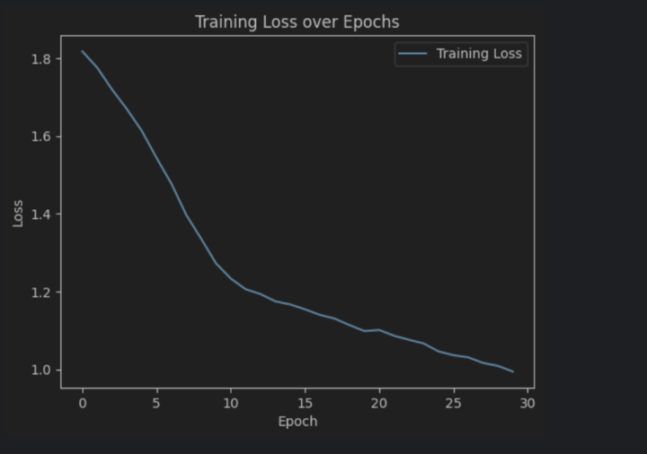
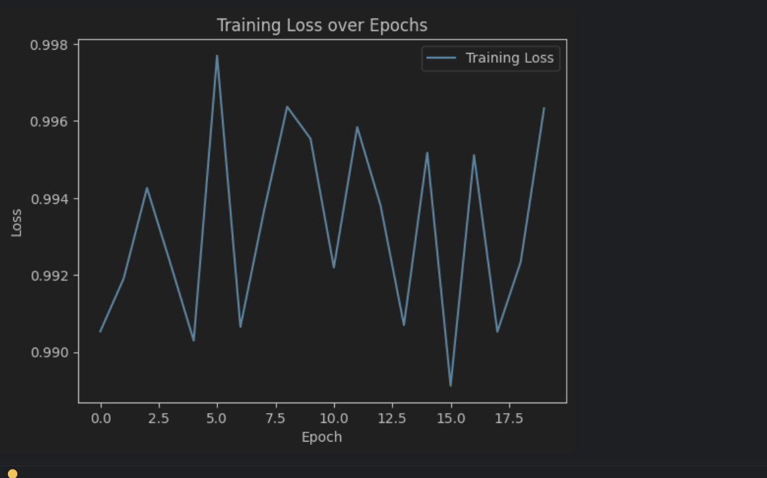
Train → Valid test → Test result
Notes:
In general, pre-trained language models are learned on a lot of text data in a self-supervised manner, and then fine-turned on downstream tasks
It is very popular and can effectively improve the performance of many of natural language processing tasks.
In the past year , one of the important trends of pre-trained language models is their increasing model size ,which leads to lower perplexity in pre-training and better performances on downstream tasks
Although they are very successful, however, they are trained on plain text and do not introduce language knowledge, world knowledge etc. In addition, these large models are trained using autoregression, which does not perform well in solving downstream language understanding problems.

Slide 19
07 Possible optimization directions
Settings and parameter optimization in neural networks
Generate data sets in the form of automatically generated feature vectors

Slide 20
1. Settings and parameter optimization in neural networks
Combat the vanishing gradient problem by setting dropout
Set bias so that the neural network can fit more complex functions
Notes:
In general, pre-trained language models are learned on a lot of text data in a self-supervised manner, and then fine-turned on downstream tasks
It is very popular and can effectively improve the performance of many of natural language processing tasks.
In the past year , one of the important trends of pre-trained language models is their increasing model size ,which leads to lower perplexity in pre-training and better performances on downstream tasks
Although they are very successful, however, they are trained on plain text and do not introduce language knowledge, world knowledge etc. In addition, these large models are trained using autoregression, which does not perform well in solving downstream language understanding problems.

Slide 21
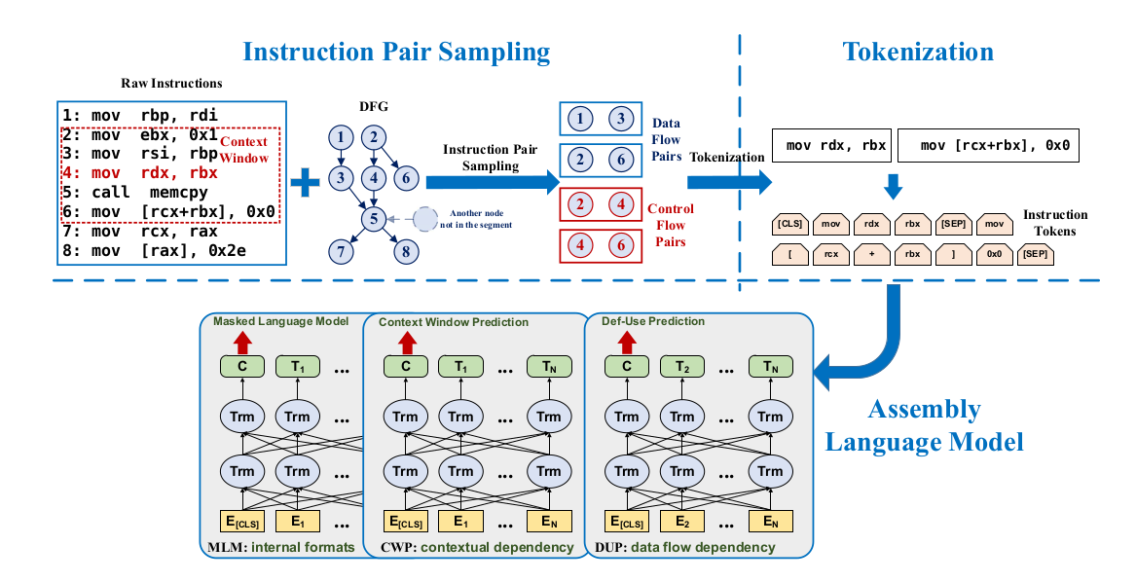
2.1. Automatically extract features based on pre-training model
Based on Data Flow Pairs and Control Flow Pairs, the model can automatically extract data relationships in blocks
Def-Use relation and Control Flows. Cite:Li, Xuezixiang, Yu Qu, and Heng Yin. "Palmtree: Learning an assembly language model for instruction embedding."
Notes:
In general, pre-trained language models are learned on a lot of text data in a self-supervised manner, and then fine-turned on downstream tasks
It is very popular and can effectively improve the performance of many of natural language processing tasks.
In the past year , one of the important trends of pre-trained language models is their increasing model size ,which leads to lower perplexity in pre-training and better performances on downstream tasks
Although they are very successful, however, they are trained on plain text and do not introduce language knowledge, world knowledge etc. In addition, these large models are trained using autoregression, which does not perform well in solving downstream language understanding problems.

Slide 22
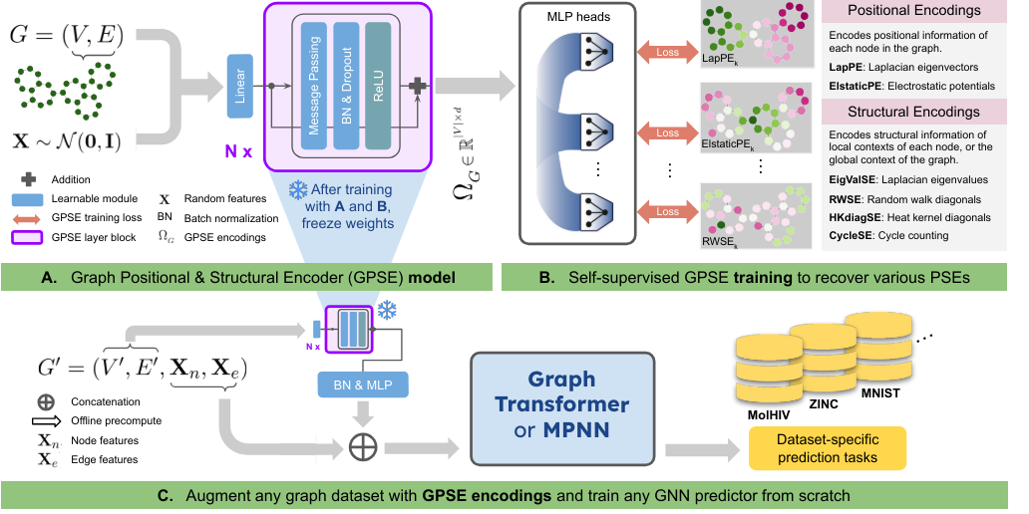
2.2 Automatically generate information embeddings of nodes relative to the graph
Use the position information of the CFG node and the surrounding structural information as the embedding vector and connect it with the feature vector cite:Liu, Renming, et al. "Graph Positional and Structural Encoder." arXiv preprint arXiv:2307.07107 (2023).
Notes:
In general, pre-trained language models are learned on a lot of text data in a self-supervised manner, and then fine-turned on downstream tasks
It is very popular and can effectively improve the performance of many of natural language processing tasks.
In the past year , one of the important trends of pre-trained language models is their increasing model size ,which leads to lower perplexity in pre-training and better performances on downstream tasks
Although they are very successful, however, they are trained on plain text and do not introduce language knowledge, world knowledge etc. In addition, these large models are trained using autoregression, which does not perform well in solving downstream language understanding problems.

